Slide 1
Process Improvement
Prof. Dr. Dirk Riehle
Friedrich-Alexander University Erlangen-Nürnberg
AMOS G01
Licensed under CC BY 4.0 International
Notes:
It is Friedrich-Alexander University Erlangen-Nürnberg – FAU, in short.
Corporate identity wants us to say “Friedrich-Alexander University”.

Slide 2
Process Improvement
Process improvement
  Is a practice of reflection, learning, adjusting of a development process to improve team performance
  Is ideally a continuously running process, in case of which process improvement may happen implicitly
  Is typically a discrete repeated process, in which a team takes time-outs to reflect and learn
A retrospective is
  A time-out used to reflect and learn
  Used to be known as “postmortem”

Slide 3
Retrospective Principles
Kerth’s prime directive
  “Regardless of what we discover, we must understand and truly believe that everyone did the best job he or she could, given what was known at the time, his or her skills and abilities, the resources available, and the situation at hand.” [K01]
  In short: “Assume good faith” [WP]
Chatham House rule
  “When a meeting, or part thereof, is held under the Chatham House Rule, participants are free to use the information received, but neither the identity nor the affiliation of the speaker(s), nor that of any other participant, may be revealed.” [C17]
  Applies to technical information
The Las Vegas rule
  “Whatever happens in a retrospective stays in the retrospective.”
  Applies to personal disclosures

Slide 4
Retrospective Process
Structure [K01] | Content
The beginning | Set-up, create safety
The middle part | Review and discussion
The ending | Resolutions and closure

Slide 5
Types of (Agile) Retrospectives
Sprint retrospective
Release retrospective
Project retrospective

Slide 6
Scope of (Agile) Retrospectives
Release Scope
Sprint Scope
Project
Scope
P
E
3R
Release
Release
Retro-
spective
Project
Retro-
spective

Slide 7
Roles by Retrospective Type
 | Facilitator | Participant | Sponsor
Project | External facilitator | Committed people Involved people | Business owner
Release | Scrum Master | Committed people Involved people | Business owner
Sprint | Scrum Master | Committed people | N / A

Slide 8
Sprint Retrospective
Sprint retrospective
  Is a retrospective for a sprint-size iteration
  Is limited to discussing the most recent sprint
  Takes about 1-4 hours, usually much less
  Assumes a well-working team
Roles and responsibilities
  Facilitator → Scrum Master
  Participants → Committed team members

Slide 9
Structure of a Sprint Retrospective
Report on impediments resolution, if any
Perform roll call on sprint
  What happened when?
  What went well?
  What went wrong?
Find solutions to impediments
Commit to implementing solutions
Prioritize impediments

Slide 10
Reflecting on Sprint (Practices)
Perform roll call on sprint
  Responsible: Scrum Master
  Artifact: Impediments backlog
  Collaborators: Team
Process of roll call on sprint
  The three components are roll-called one after another
    What happened when
    What went well
    What went wrong (impediments)
  The Scrum Master takes note of impediments

Slide 11
Managing Impediments (Practices)
Find solutions to impediments
  Responsible: Facilitator / Scrum Master
  Artifact: Impediments and impediments backlog
  Collaborators: Team
Prioritize impediments
  Responsible: Facilitator / Scrum Master
  Artifact: Impediments and impediments backlog
  Collaborators: Team
Report on impediment resolution
  Responsible: Facilitator / Scrum Master
  Artifact: Impediments and impediments backlog
  Collaborators: None

Slide 12
Release Retrospective
Release retrospective
  Is a retrospective for a product release
  Can take a day or more, depending on the release
Roles and responsibilities
  Facilitator → Scrum Master
  Participants → Committed and involved team members

Slide 13
Structure of a Release Retrospective
Create safety
Develop and mine time-line
  What happened when?
  What went well?
  What went wrong?
Find solutions to impediments
Commit to implementing solutions
Prioritize impediments

Slide 14
Create Safety (Practices) 1 / 3
Affirm ground rules
  Responsible: Facilitator / Scrum Master
  Artifact: None
  Collaborators: None
Examples of ground rules
  Kerth’s prime directive
  Speak to issues, not people
  Do not interrupt person speaking

Slide 15
Create Safety (Practices) 2 / 3
Check safety
  Responsible: Facilitator / Scrum master
  Artifact: None
  Collaborators: Team
Process of checking safety
  Anonymously poll
  If all agree, move on
  If not all agree, discuss
Eventually move on, safe or not

Slide 16
Create Safety (Practices) 3 / 3
Address problems
  Responsible: Facilitator / Scrum master
  Artifact: None
  Collaborators: Team
Process of addressing problems
  In third-person, suggest reasons
  Put reasons on post-it on board
  Jointly discuss, suggest resolutions

Slide 17
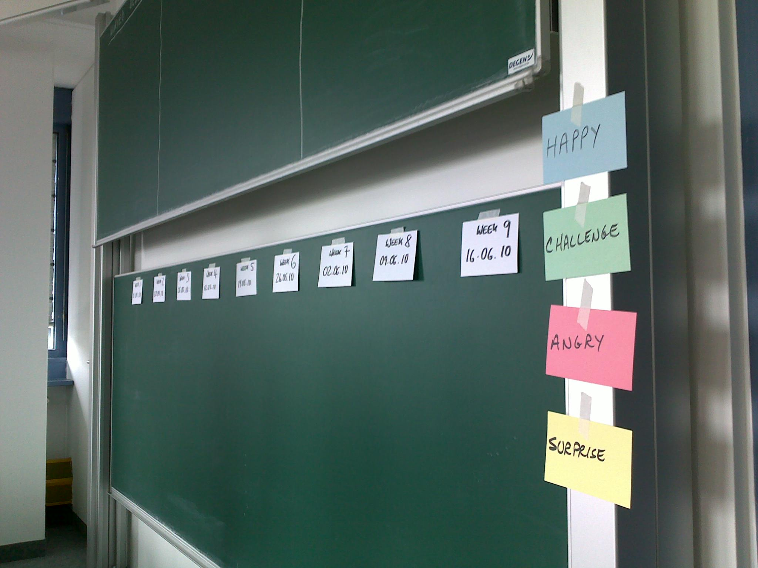
Develop Time-Line (Practice) 1 / 2

Slide 18
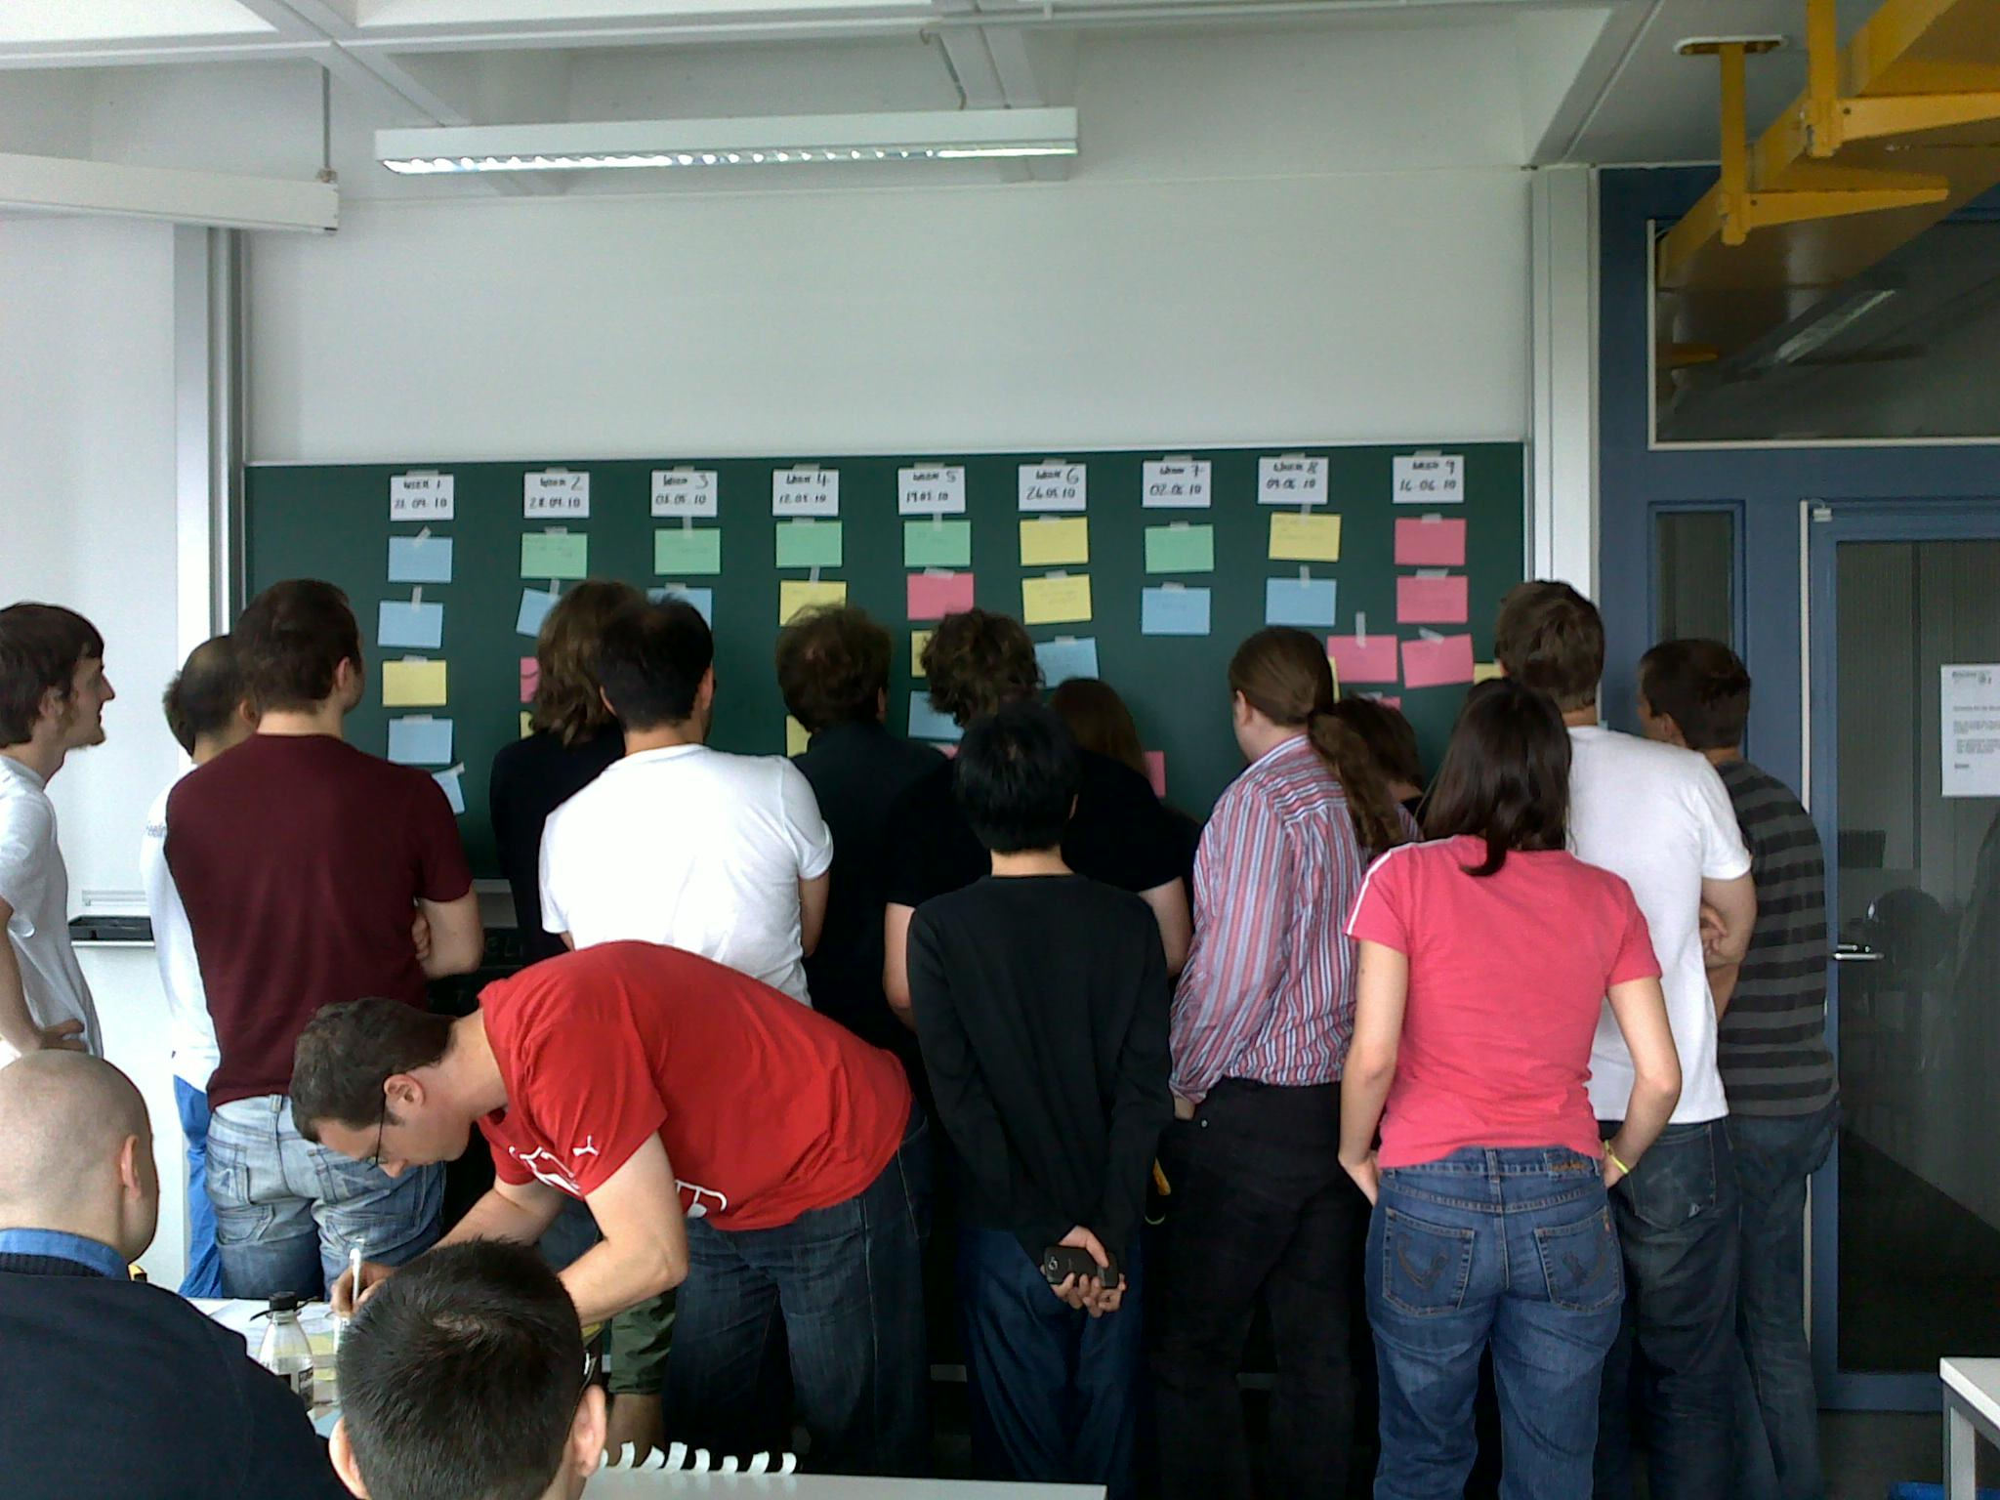
Develop Time-Line (Practice) 2 / 2

Slide 19
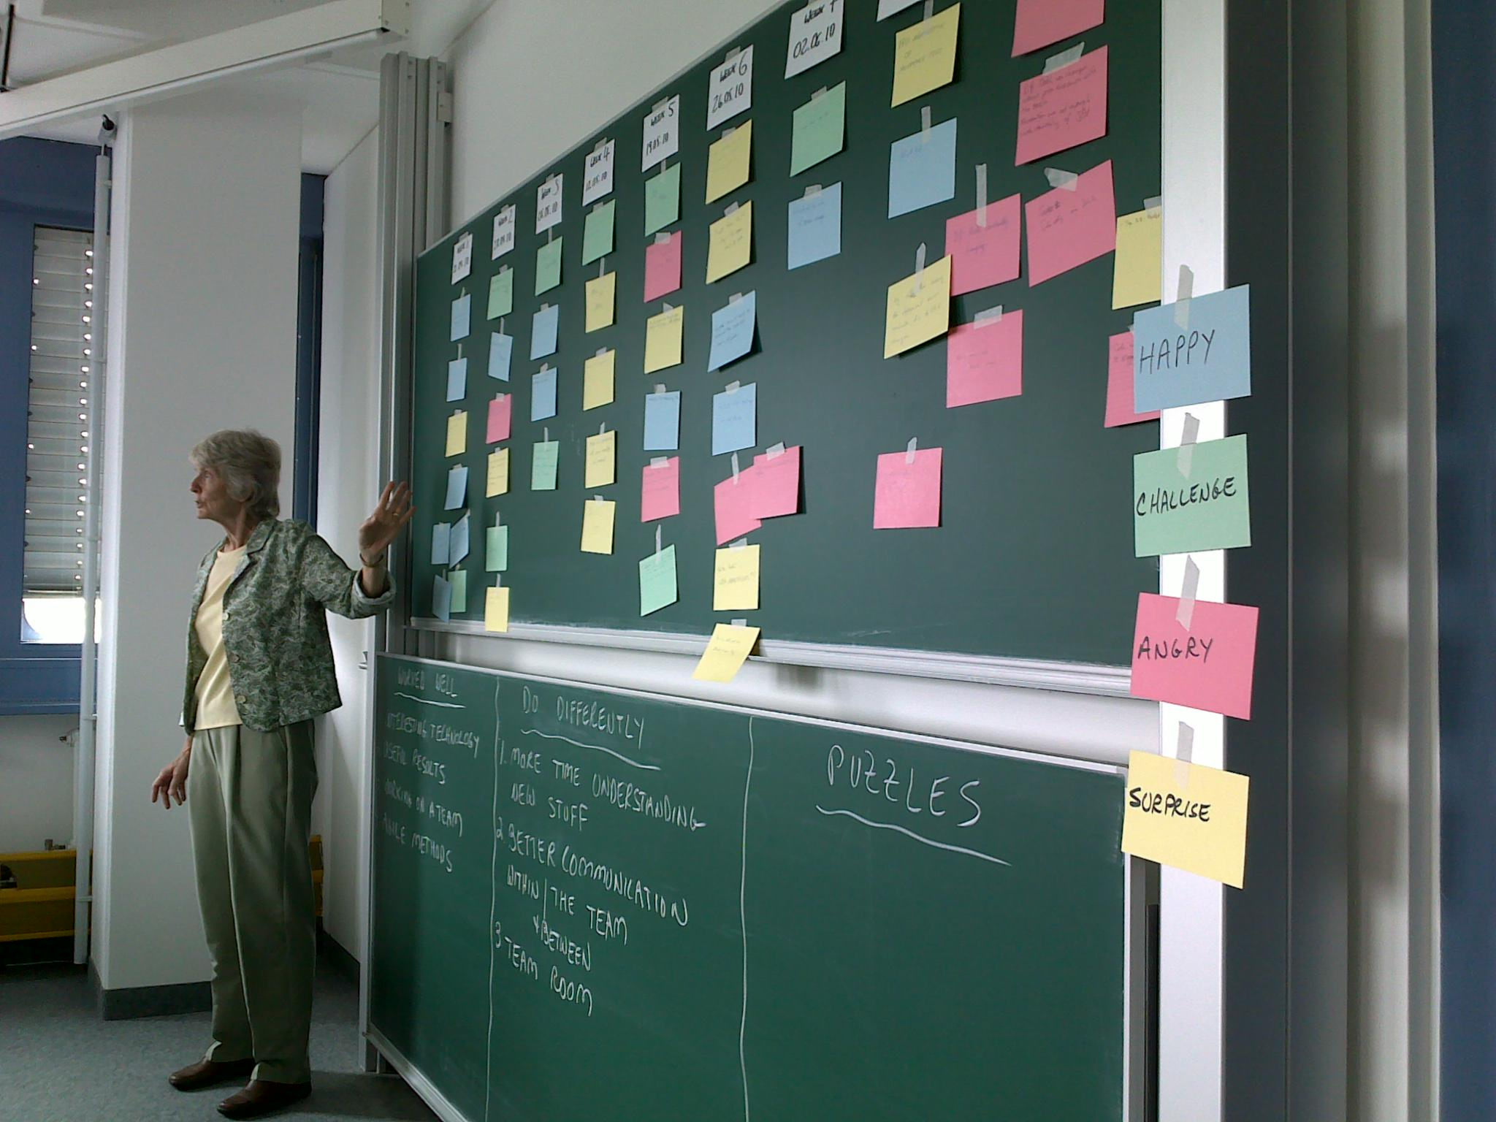
Mine Time-Line (Practice)

Slide 20
Develop and Mine Time-Line (Practices)
Develop and mine time-line
  Responsible: Facilitator / Scrum master
  Artifact: Time-line
  Collaborators: Team
Process of developing the time-line
  One after another, put down post-its on
    What happened when?
    What went well?
    What went wrong?
Process of mining the time-line
  Review and correlate events
  Understand problems and causal effects
  Take notes on root causes

Slide 21
Project Retrospective
A project retrospective
  Is a retrospective on the whole project
  Replaces the final product release retrospective, if any
  May take 2-3 days (one day is usually too short)
Roles and responsibilities
  Facilitator → Scrum Master
  Participants → Committed and involved team members
In AMOS, student teams write a letter to next year’s students

Slide 22
Structure of a Project Retrospective 1 / 2
Setting the stage (beginning, “the readying”)
  Lead participants to feel comfortable
  Create safe and positive atmosphere
Reflection and learning (middle part, “the past”)
  Review and articulate project learnings
  Recognize and repair relationships, personal damage
Conclusions (ending, “the future”)
  Articulate behaviors and activities needed to improve
  Set tangible goals to realize these improvements

Slide 23
Best Practices of Project Retrospectives
Beginning: The Readying | Middle Part: The Past | Ending: The Future
Introduction I’m too busy Define success Create safety | Artifacts contest Develop a time-line Offer appreciations Passive analogy Emotions seismogram Sessions without managers Repair damage through play | Cross-affinity teams Making the magic happen Change the paper Closing the retrospective

Slide 24
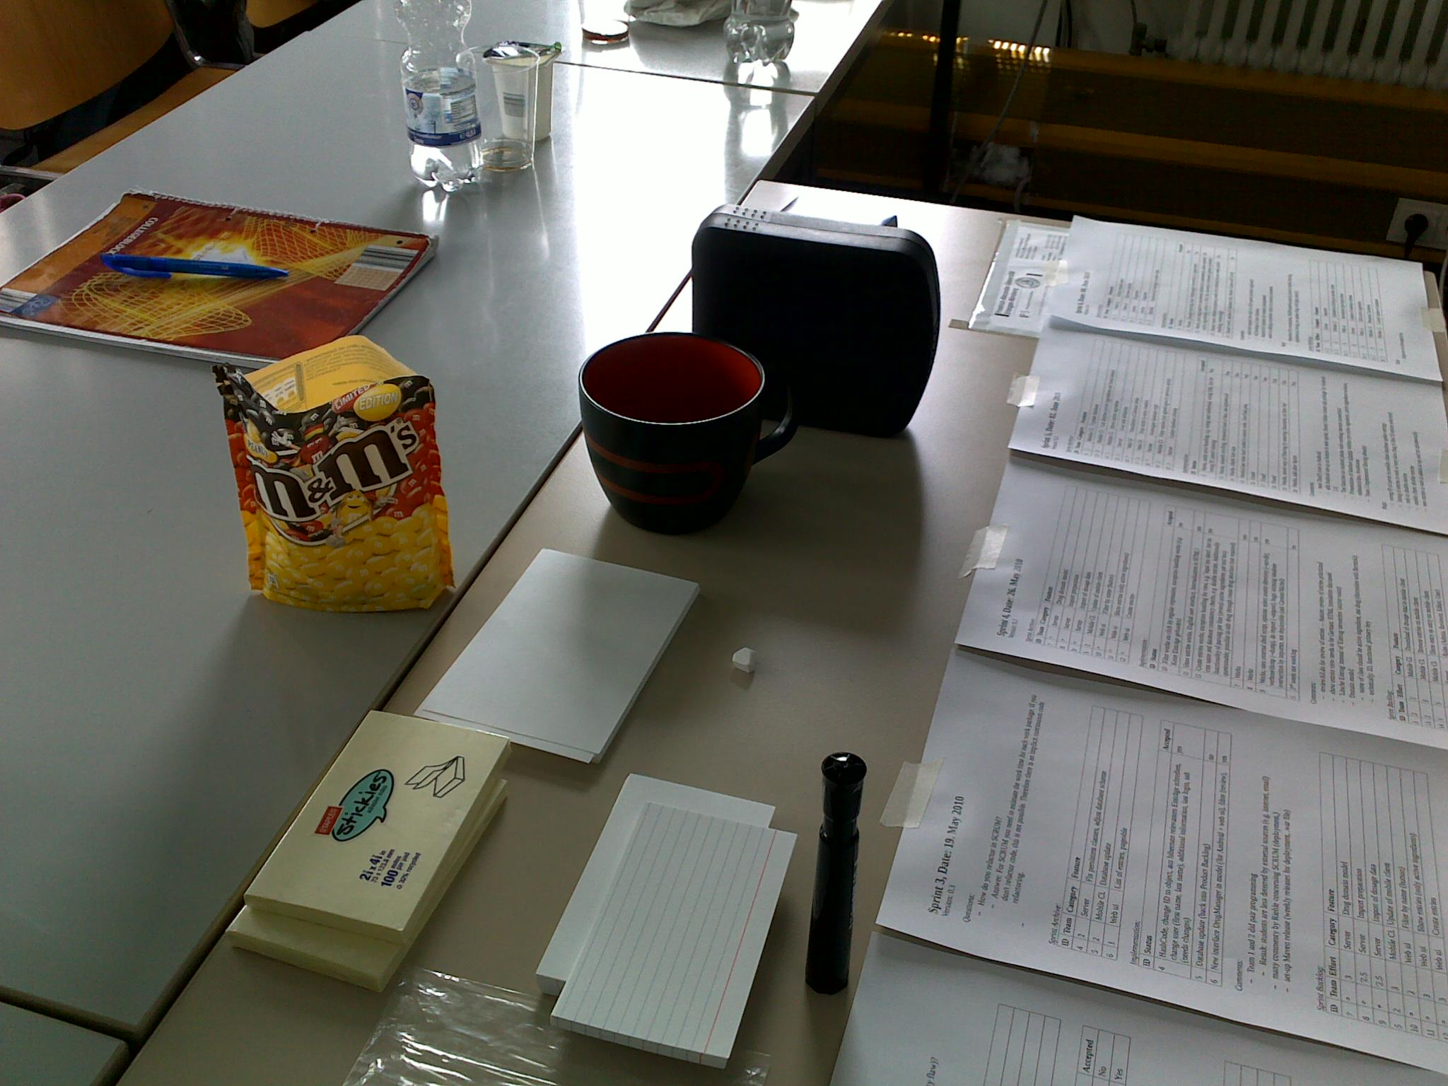
Artifacts Contest (Practice)

Slide 25
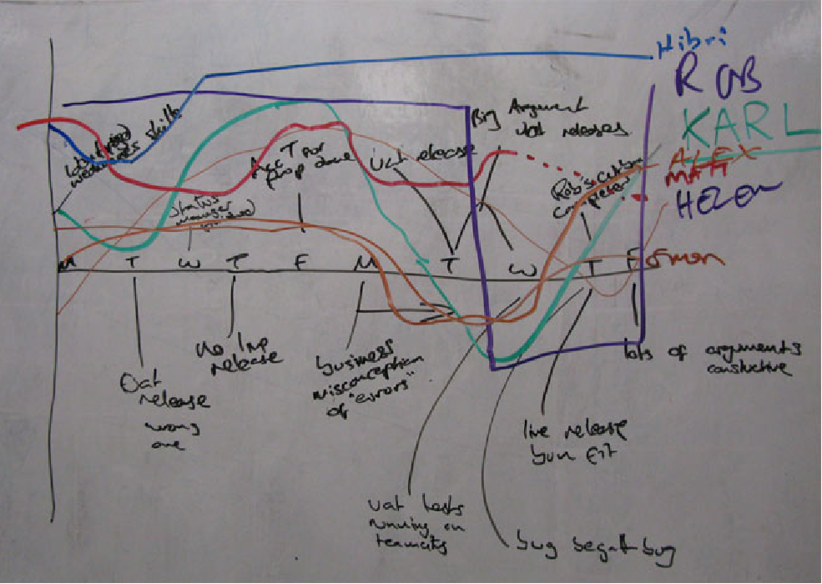
Emotions Seismogram (Practice)

Slide 26
Functional vs. Dysfunctional Organizations
Functional Organization
  Honest communication
  Trust and cooperation
  Appreciation, all of us
  Encouragement to improve
  Team achievements
  Constructive meetings
  Feeling of being empowered
  Consensus-based decisions
Dysfunctional Organization
  Guarded language
  Distrust between groups
  Lack of respect, us vs. them
  Pressure to produce
  Competition and survival
  Confrontational meetings
  Feeling of being powerless
  Unilateral power decisions

Slide 27
Quality Criteria of Retrospectives
The entire team is engaged
The discussion focuses on the issues
The discussion is relevant for all participants
The retrospective creates actionable resolutions

Slide 28
Review / Summary of Session
Process improvement
  Definition and components
  Process context
Agile retrospectives
  Types of retrospectives
    Sprint retrospective
    Release retrospective
    Project retrospective
  Process and practices

Slide 29
Thank you! Questions?
dirk.riehle@fau.de – http://osr.cs.fau.de
dirk@riehle.org – http://dirkriehle.com – @dirkriehle
DR

Slide 30
Credits and License
Original version
  © 2021 Dirk Riehle, some rights reserved
  Licensed under Creative Commons Attribution 4.0 International License
Contributions
  None yet

